Slide 1
Car Analysis
SQL Project
Presented by Pratik Rangire

Slide 2
Description
This project involves analyzing the fuel type distribution across four major car brands: Audi, BMW, Hyundai, and Mercedes. The goal is to understand the prevalence of different fuel types within each brand and compare them to see if any patterns or trends emerge. The analysis is conducted using SQL to aggregate and join data from different tables representing each car brand.

Slide 3
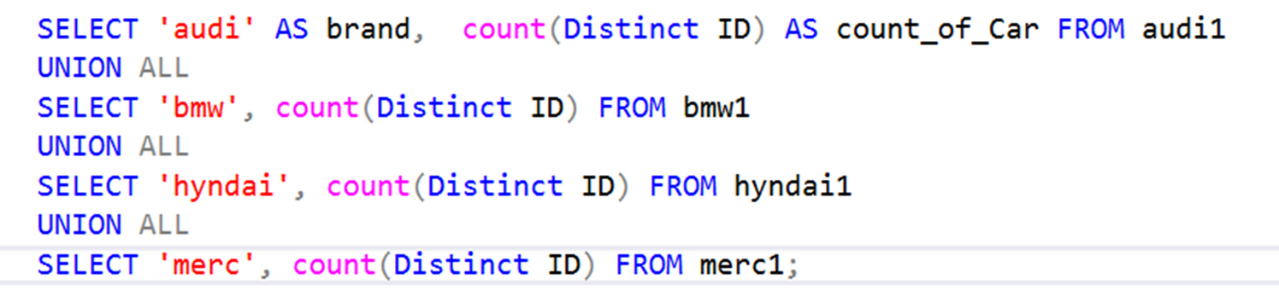
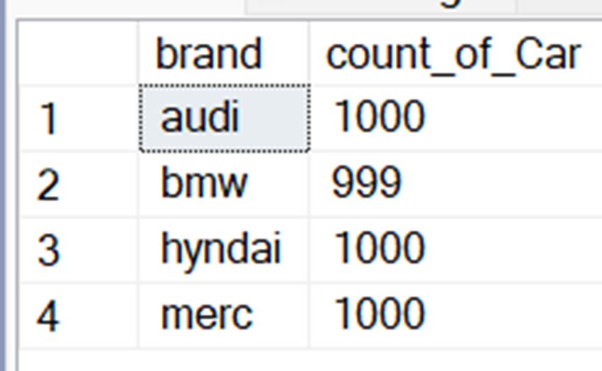
Each Car brand How many car

Slide 4
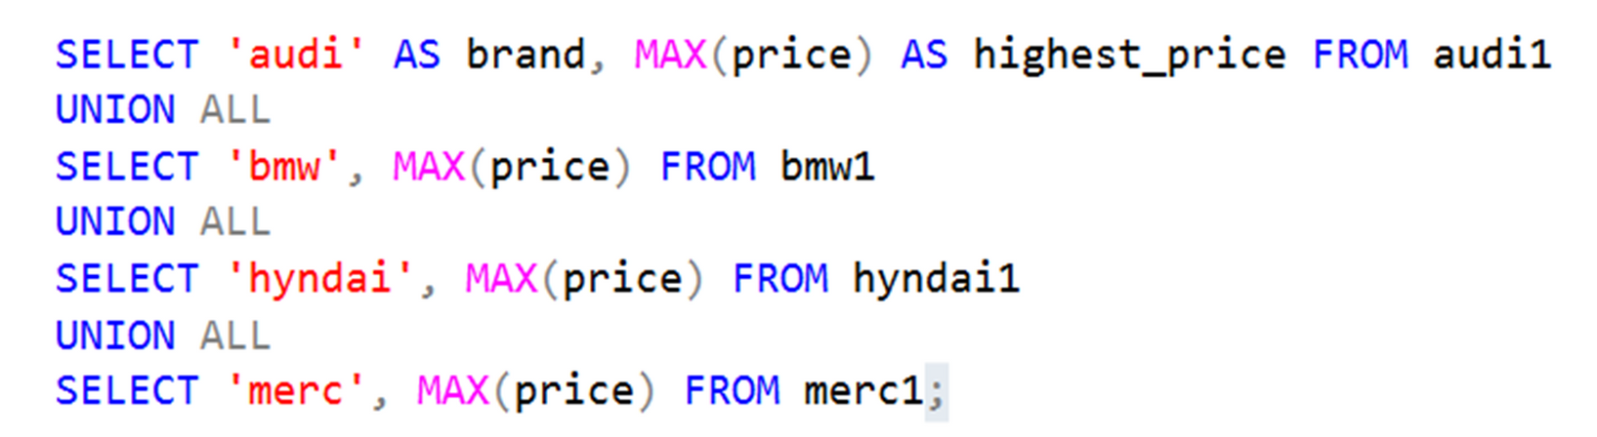
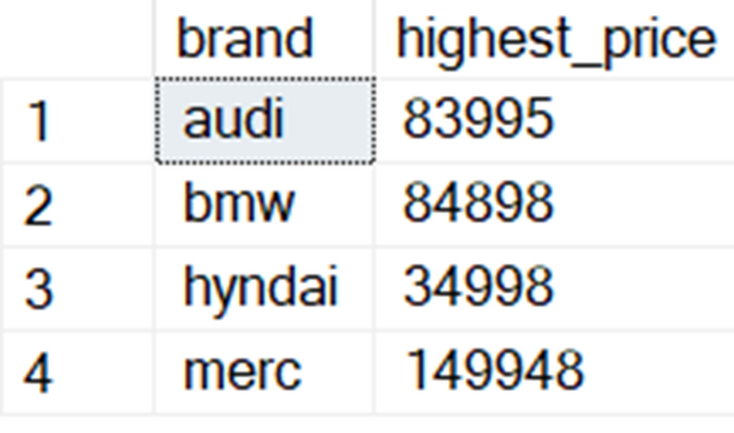
BrandWisehighest_priceCompareEachother

Slide 5
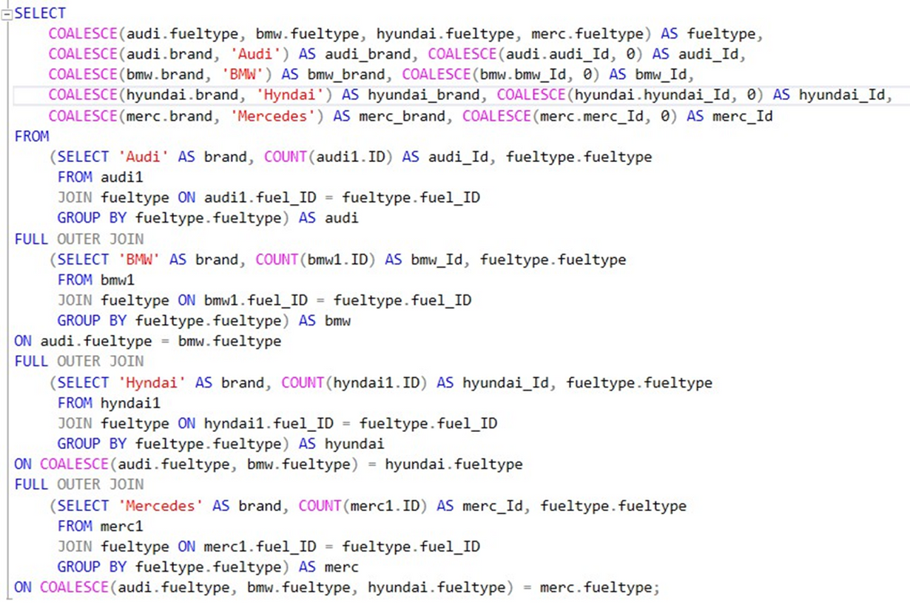
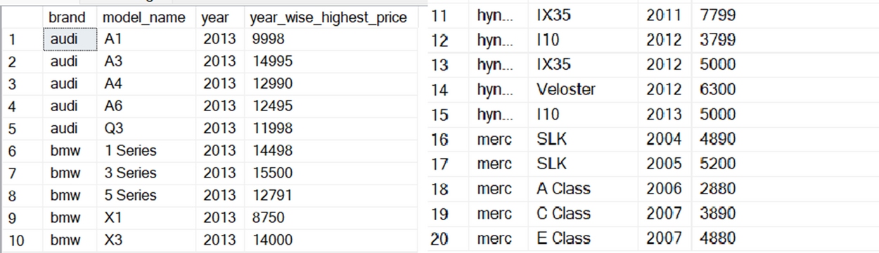
Each car brand find no of car use of type of fuel

Slide 6
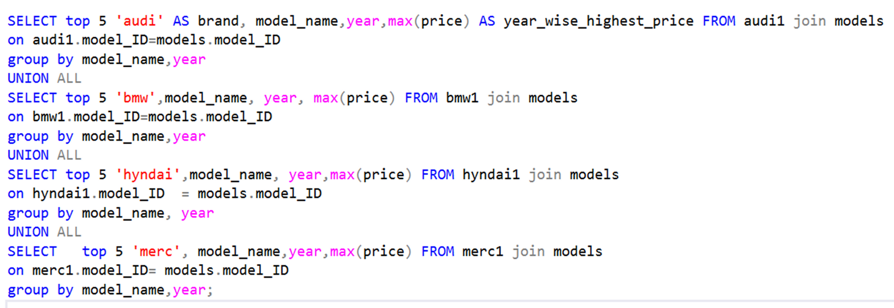
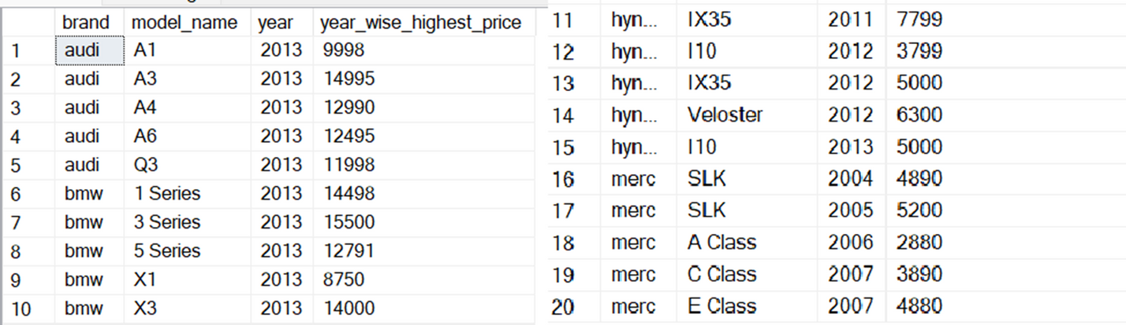
Each car brand yearly wise highest price(Top 5)

Slide 7
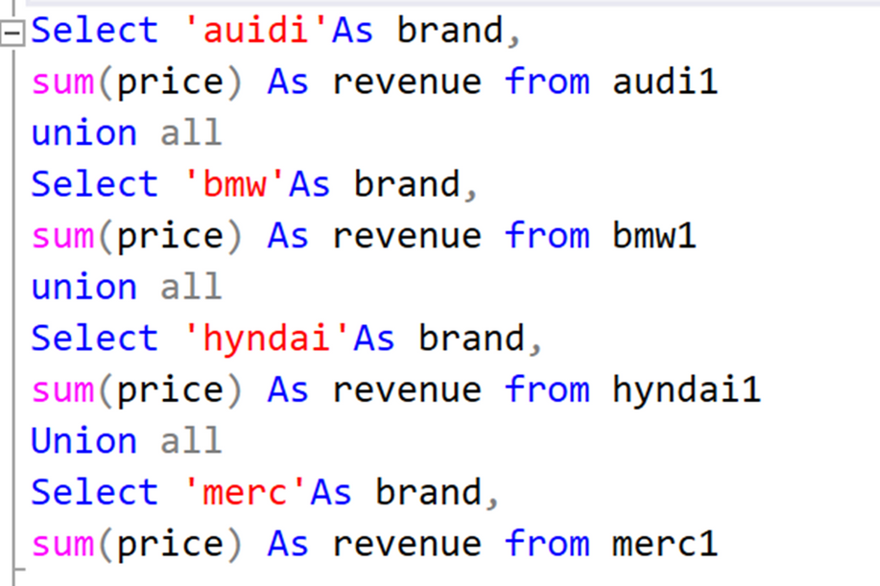
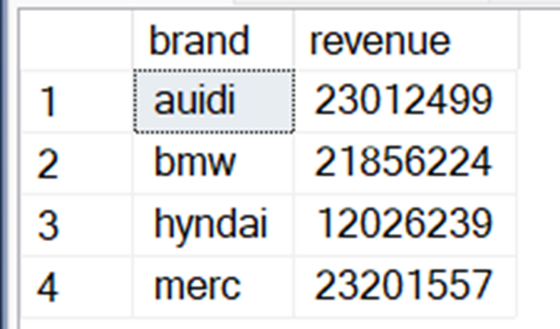
Brand wise total revenue

Slide 8
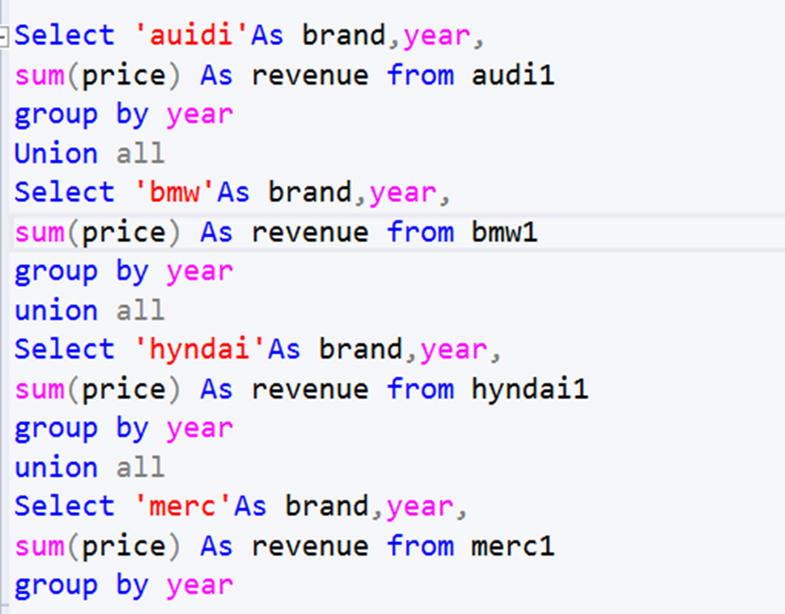
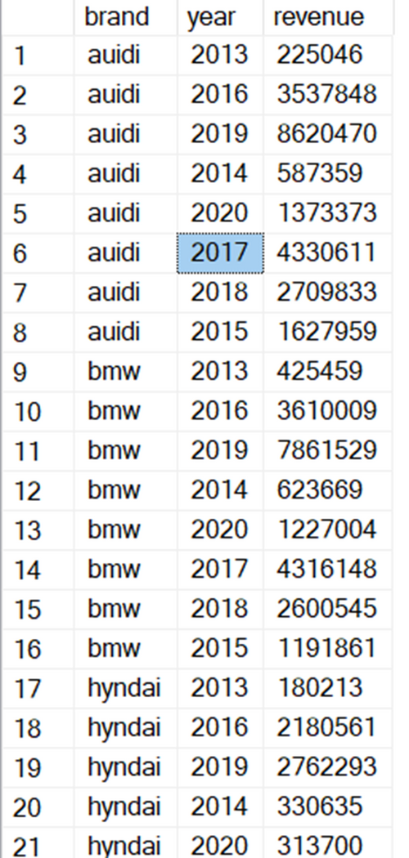
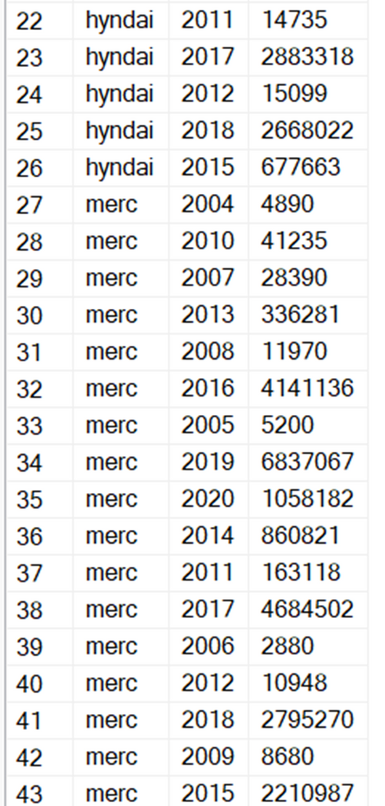
Brand and yearly wise total revenue

Slide 9
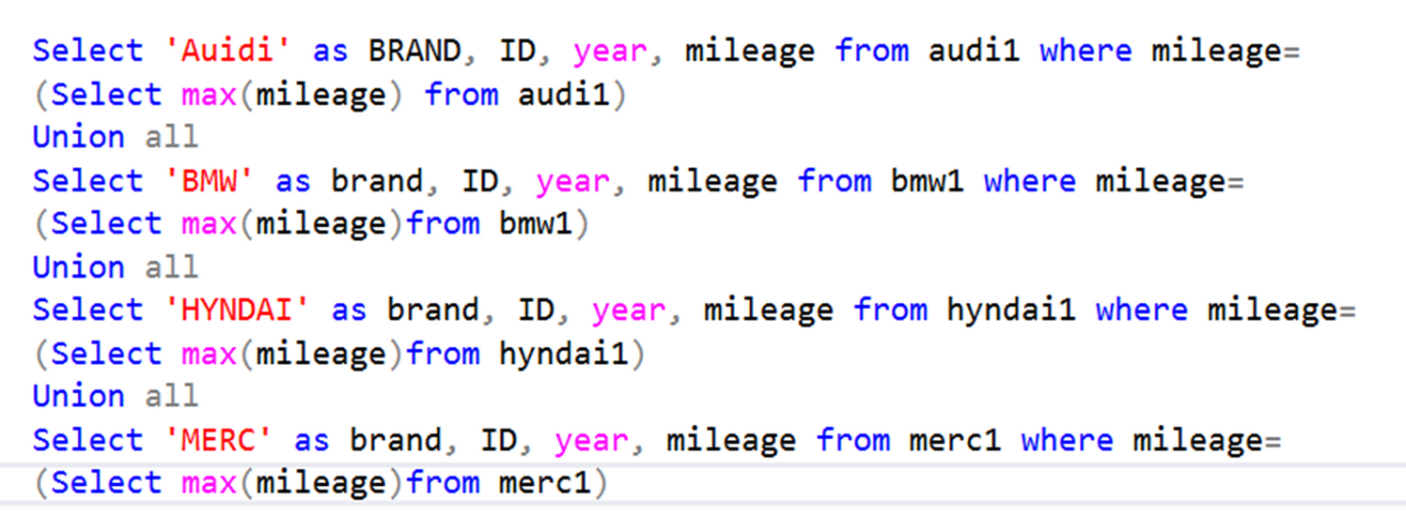
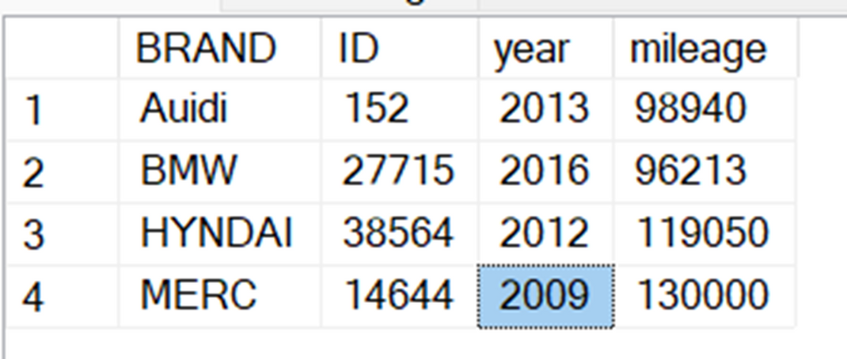
7.Brand according highest mileage with year and ID

Slide 10
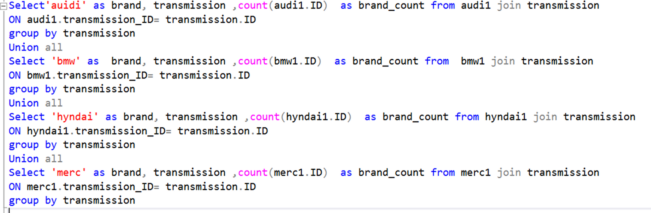
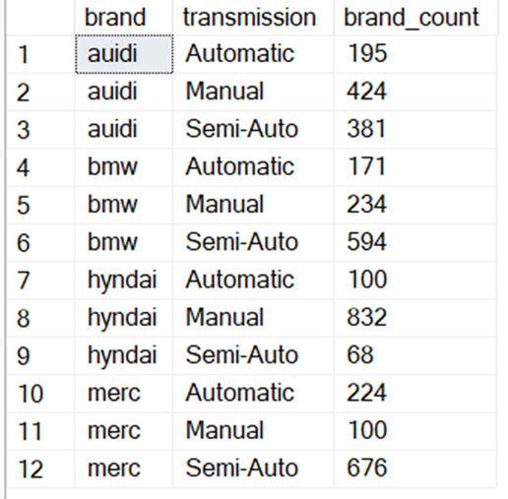
How many car brand type of transmission

Slide 11
Conclusion
This analysis provides a comprehensive view of fuel type distribution across four major car brands. By leveraging SQL, we were able to effectively aggregate and compare the data. The findings can help manufacturers and marketers understand market trends and consumer preferences for different fuel types within each brand.

Slide 12
Thank you

